Slide 1
Web App for direct Market Access for Farmers
CSE7101- Capstone Project
Review-2
Batch Number : pscs_281
Roll Number | Student Name
20221CDV0001 | Suman S
20221CDV0009 | p.Lakshmi Narashimha
20221CDV0013 | Wasim akram
Under the Supervision of,
Ms.Shana Aneevan
Assistant Professor
Mr.Anadhan B
School of Computer Science and Engineering
Presidency University
Name of the Program: CDV
Name of the HoD: Dr. Pravinthraja S
Name of the Program Project Coordinator: Dr. H M Manjula
Name of the School Project Coordinators: Dr. Sampath A K , Dr. Geetha A

Slide 2
Content:
Problem Statement
Objectives
Exiting Methods and Drawbacks
Analysis of Problem Statement
Proposed Method & Flexibility Study
Git-hub Link
Architecture Diagram
Modules
Hardware & Software details
Timeline of the Project
References

Slide 3
Introduction
Organization: Ministry of Agriculture and Farmers Welfare
Category : Software
Problem Description:
Financial Disadvantage: Middlemen dictate prices, cutting into farmer profits.
Information Gap: Farmers lack real-time data on market prices and demand.
Inefficient Supply Chain: The long chain leads to post-harvest waste and spoilage.
Limited Financial Access: Cash-based transactions prevent farmers from building a formal credit history.
Low Price Discovery: Farmers have no mechanism to negotiate prices or find the best buyer for their produce

Slide 4
Problem Statement
Farmers are forced to sell their produce at low, dictated prices to middlemen, leading to minimal profits that barely cover their costs.
Farmers lack access to real-time market prices, demand, and consumer preferences, which prevents them from making informed decisions about what to grow and when to sell.
The traditional supply chain is long and fragmented, with multiple intermediaries, leading to significant delays and physical post-harvest losses.
Farmers have no platform to negotiate prices or compare offers, forcing them to accept the first price they are given without knowing its fairness.
Farmers largely operate on a cash-based system with no formal transaction history, making it difficult to access institutional credit and loans from banks.

Slide 5
Objectives
*Financial Empowerment: Increase farmers' income by eliminating middlemen.
* Price Transparency: Provide fair pricing through direct market access and real-time data.
* Supply Chain Efficiency: Reduce post-harvest losses with streamlined logistics.
* Wider Market Access: Connect rural farmers to a broader consumer base.
* Financial Inclusion: Help farmers build a credit history through digital transactions.
* Build Trust: Foster direct relationships between farmers and consumers.

Slide 6
Existing Methods and Drawbacks
1. Traditional Middlemen-Based
Used by:Dealers
Method:Farmers sell produce to local agents/middlemen who connect them to markets.
Drawbacks:
• Farmers get lower prices due to multiple intermediaries.
• Lack of transparency in pricing.
• Delays in payment.
• Exploitation of small farmers.
2.Direct Retail / Contract Farming
Used by: Farmers and Consumers
Method: Farmers directly supply to supermarkets, retailers, or via apps connecting them with consumer
Drawbacks:
• Small farmers may not meet quality and volume requirements.
• Risk of dependency on a single buyer/retailer.
• Lack of bargaining power.
• Logistics challenges in handling small-scale deliveries.

Slide 7
Proposed Method & Feasibility Study
STAGES
FARM LEVEL
TRANSPORT
PROCESSING
MARKET ACCESS
CERTIFICATION
CONSUMER ACCESS
FEATURES
1.Farmer registration on the app (with mobile number / Aadhaar verification).
2.Product listing with details (crop type, quantity, expected price, quality grade, harvest date).
1.Buyers can arrange transport or request logistics support via the app
2.Integration with local transport providers
3.Real-time shipment tracking (GPS)
1.Options for buyers to request cleaning, grading, or storage services.
2.Integration with local warehouses / cold storage
1.Farmers can view bids from buyers (wholesalers, retailers, direct consumers)
2.Secure payment gateway integration (UPI, bank transfer, wallets)
1.Certification of quality (government/NGO/verified labs)
2.Buyers can verify source and sustainability
1.Buyers and consumers can scan QR codes to verify authenticity, farmer details, and supply chain information
2.Transparent origin tracking ensures trust and fair trade.

Slide 8
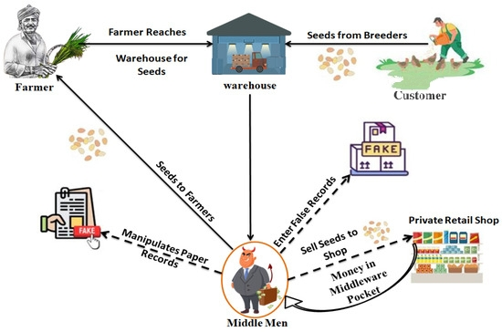
Architecture Diagram

Slide 9
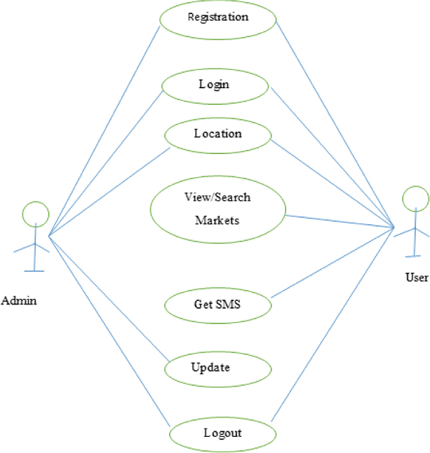
Use Case Diagram

Slide 10
Timeline
PHASE | DURATION | ACTIVITIES
Requirement Analysis | Week 1 | Stakeholder interviews, system requirements
Design | Weeks 2–3 | UI/UX, Architecture
Development Phase I | Weeks 4–7 | Farm & transport module
Development Phase II | Weeks 8–10 | Processing & manufacturing module
Testing | Week 11 | Functional and integration testing
Deployment | Week 12 | Pilot launch
Review & Feedback | Week 13 | Evaluation and iteration

Slide 11
Analysis of Problem Statement
Technology Stack Components:
1. Frontend (User Interface)
HTML5 / CSS3 – for designing web page layout and styling.
JavaScript – for making the web app interactive.
Flutter- quick prototyping and debugging in a web app
2. Database
MySQL / PostgreSQL – for storing data like farmer records, wool batches, processing stages, etc.
3.Optional Features
Data Analytics Tools – for insights on wool tracking, supply chain metrics, etc.
Mobile App (Optional) – can be built using React Native or Flutter.
Cloudhosting- focus on app development

Slide 12
Modules
1. User Registration & Roles (Farmers, Buyers, Transporters,Admins)
2. Produce Listing & Inventory Management
3. Order Placement & Tracking
4. Payment Gateway & Transaction Management
5. Logistics & Delivery Integration
6. Market Price & Advisory Services
7. Certification Upload & Verification (KYC, Quality Certificates)
8. Consumer Transparency Portal (Traceability, QR Code for produce)
9. Analytics & Reporting (Sales, Demand, Supply Trends)

Slide 13
Hardware & Software Details
Hardware:
Smartphones/tablets (for data entry & QR scanning)
Internet Connection
Power Solutions
Software:
Frontend: Flutter or React
Backend: Node.js / Django
Database: Firebase / PostgreSQL
Cloud: AWS / Google Cloud
APIs:Integration with Payment Gateways
Version Control: GitHub

Slide 14
Github Link
The Github link provided should have public access permission.

Slide 15
Literature Survey
P Devika & Mathu kumar (2025)
Agriconnect: A Mobile Solution for Direct Farmer-to-Market Trade
This study proposes a mobile application for Direct Market Access (DMA), where farmers can directly contact consumers, eliminating middlemen, and promoting fair trading practices. The platform does not empower farmers to list products, set prices, and interact with buyers.
2. Dillon Pikulik & Nicholas Burlakov (2025)
Saving Farmers One App at a Time
Small farmers do not have access to a platform made just for selling their crops. Because of this they often struggle to sell their produce before it spoils, forcing them to accept low prices, pay for costly storage, or rely on middlemen who take a share of their profits
3.M Bhende & S Patil (2018)
Digital Market: E-commerce application for Farmers
The term digital market means a platform that is dedicated to integrate farmer, Merchant/Markets, government and end user and thereby bridge the gap between them. It also let everyone to be updated with the changing market scenario. Indian farmers faced many challenges and one of them is that to get a good profit for the efforts and investment that they had put in.

Slide 16
References (IEEE Paper format)
1.SMART KISAN: A Mobile App for Farmers' Assistance in Agricultural Activities (2023)
The research concludes that SMART KISAN is a transformative tool for farmers, offering personalized support, actionable insights, and improved market access, thereby promoting sustainable, efficient, and profitable agricultural practices smartkisan
2. AGRI SUCCOR: Mobile Application for Agriculture (2019)
While AGRI SUCCOR is a proposed application, its features align with broader trends in agricultural mobile apps, such as AgriSage, which integrates AI for disease detection and market access. For comparison, apps like AgriSage use deep learning models (e.g., MobileNetV2) for plant and disease detection, achieving high accuracy and real-time support, which could inspire further development of AGRI SUCCOR. APP
3. Masa: AI-Adaptive Mobile App for Sustainable Agriculture (2021)
Masa exemplifies how AI-adaptive mobile applications can revolutionize agriculture by empowering farmers with data-driven tools and market access. While challenges remain, its potential to enhance productivity, sustainability, and farmer livelihoods positions it as a promising model for future agri-tech innovations. For further details, the original paper is available on ResearchGate. MASA

Slide 17


